Slide 1
Predictive Data-Driven Operating Model (DDOM) for DMe
Anish Dulla | DMe Financial Planning & Analysis (FP&A) An AI approach to forecast the customer journey experience

Slide 2
Executive Summary
OBJECTIVE
DDOM seeks to fulfill the following goals:
Guide quarterly ARR expectations
Automate forecasts into a single, robust model
Evolve QRF and Strat/Ops Plans to an AI Funnel Based Forecast
APPROACH
DDOM forecasts ARR using a customer journey funnel. Uses built web traffic, orders, gross new subscriber forecasts, and historical ARR actuals to make an ARR forecast on a weekly cadence.
RESULTS
DDOM has already proven to be extremely promising. A high-level forecast of ARR for FY23 Q4 is 99.6% accurate with current manual forecast techniques across FP&A – with benefits of both using a bottoms-up funnel approach & economizing labor hours.

Slide 3
What is DDOM?

Slide 4

Customer Journey Manager Model
ADOBE PATENT INNOVATION
Discover
Try
Buy
*Traffic:100
Downloads:6
Orders:1.3
GN units:1
Surface Traffic
New Visits
Checkout Traffic
Sign-Ups
New Trialists
Orders
Gross New Subs
Gross New ARR
*DDOM Numbers are for representational purposes only

Slide 5
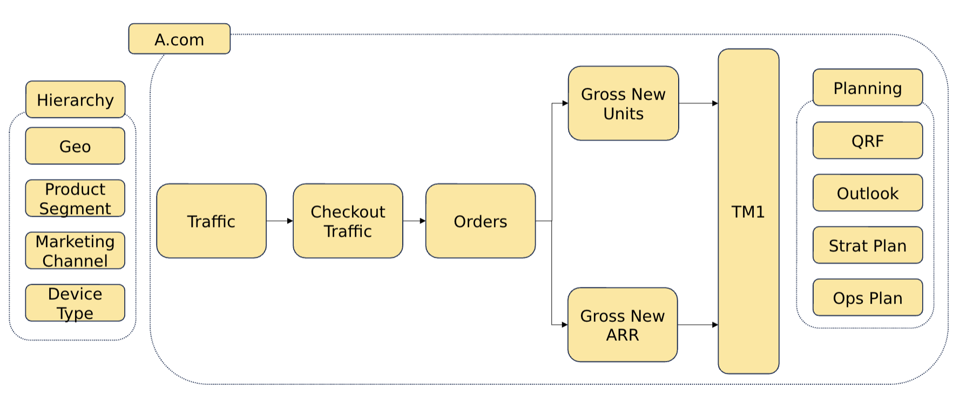
DDOM Overview
ADOBE PATENT INNOVATION

Slide 6
Automation and Value-Add
Raise the bar.
DDOM’s technology stack is the first in FinOps to use:
Databricks – powerful & modern data pipelining
Github – dynamic version control for collaboration
Create the future.
DDOM transforms manual and rudimentary forecast processes across FP&A into an automated system that capitalizes on AI capabilities.
Leveraging AI
DDOM leverages a Machine Learning driven approach to make scalable, robust, and accurate forecasts. Estimated to save hundreds of hours per year in FP&A processes.
.

Slide 7
DDOM Methodology

Slide 8
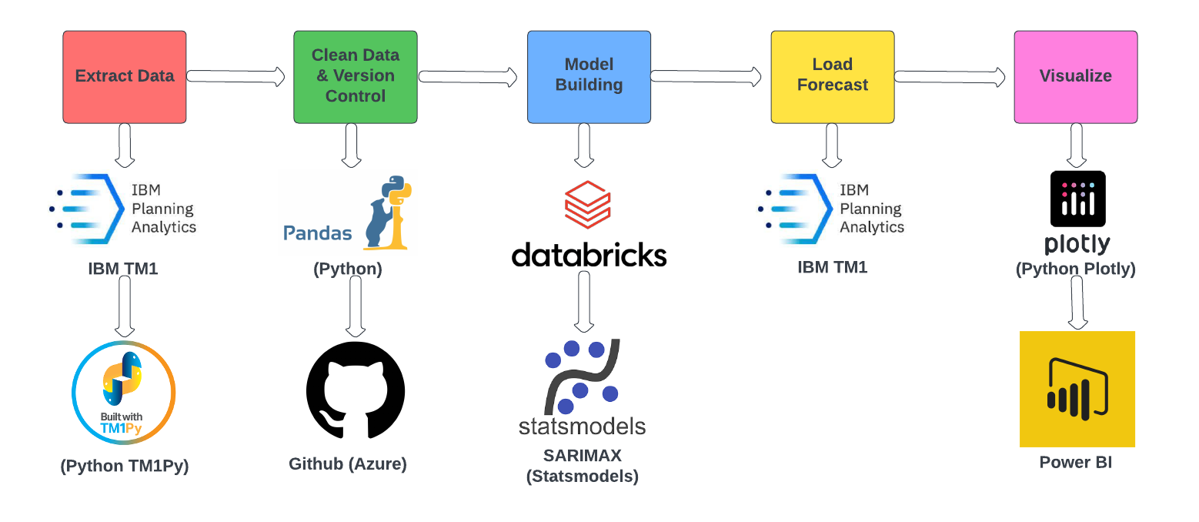
DDOM Leverages Python, IBM TM1, Databricks, and Power BI Technologies

Slide 9
DDOM Uses an Ensemble Model
DDOM utilizes an ensemble model as the most accurate forecasting approach.
Aggregated Results
Leverages two AI models
Reduces Error in Forecast
Most Stable Forecasts
Ensemble
SARIMAX
Prophet

Slide 10
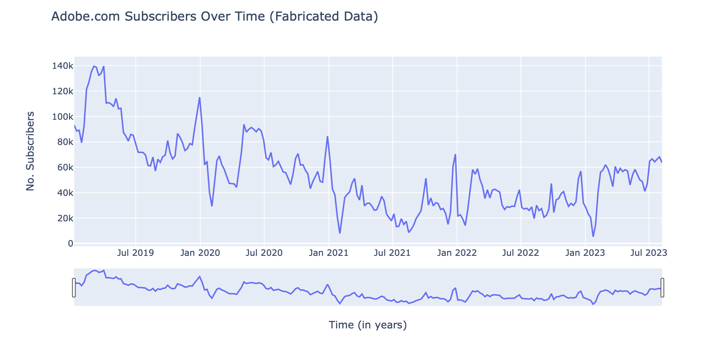
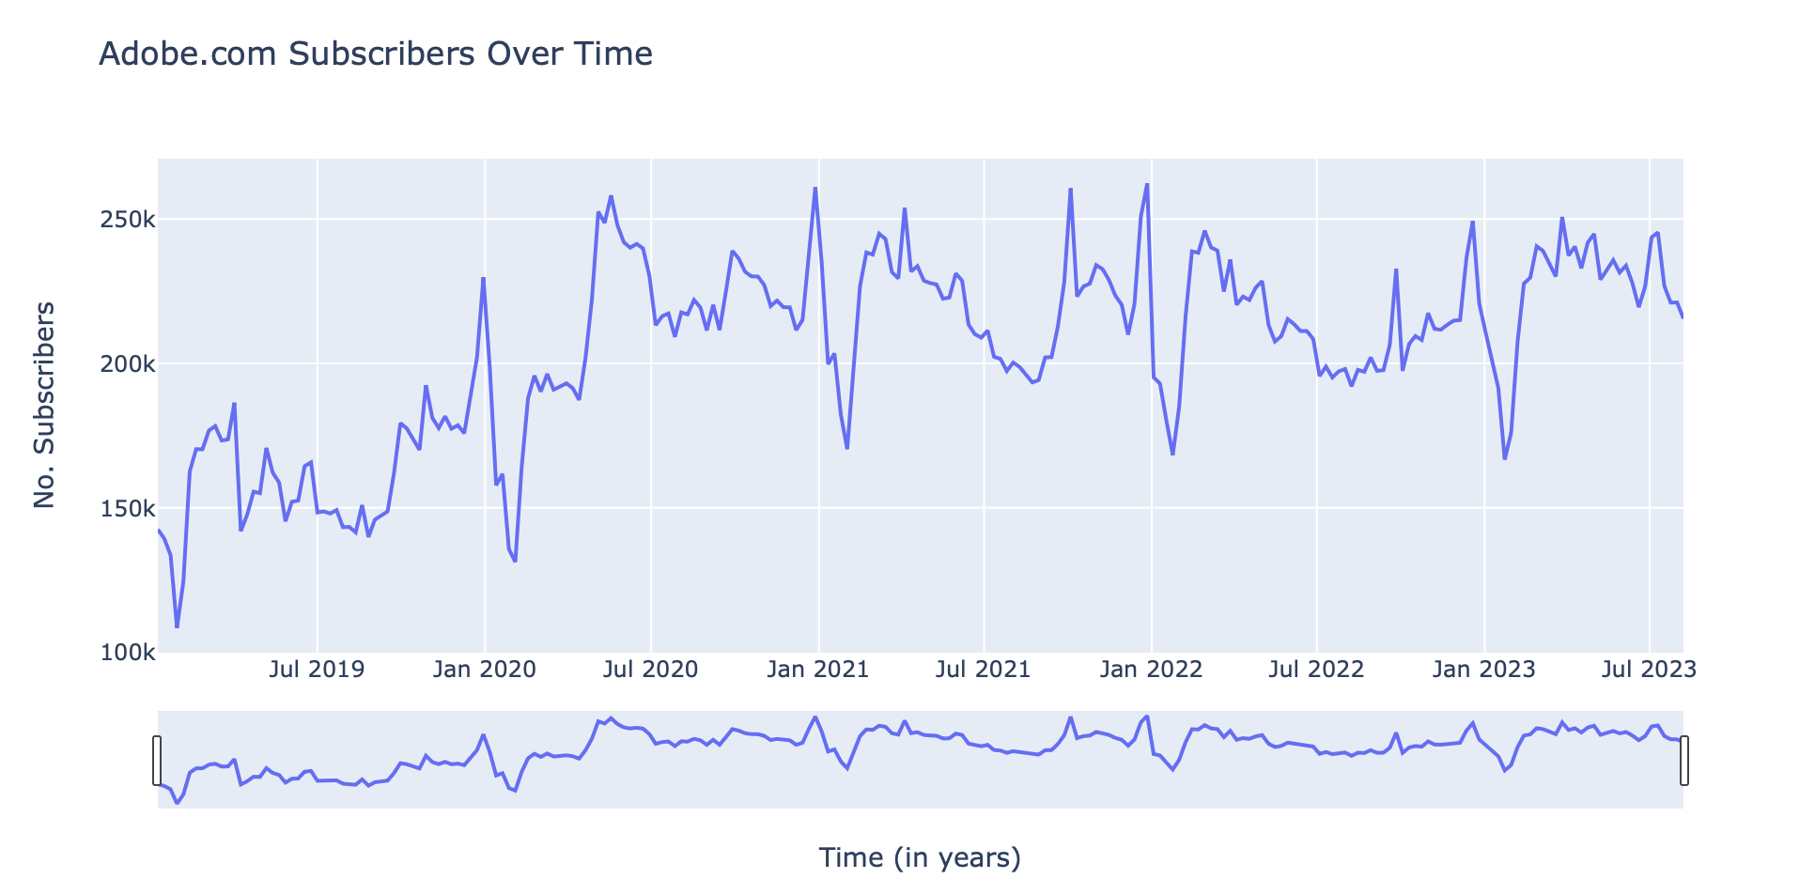
SARIMAX Model
SARIMAX is a commonly used machine learning model for time series forecasting. The term SARIMAX is an acronym of its components:
Seasonality (quarterly)
Auto Regression (historicals)
Integration (differencing)
Moving Average (trend)
EXogenous (regression)
¹ Dataset is fabricated as financial data is confidential to Adobe Finance and Operations

Slide 11

Prophet Model
Prophet is a highly customizable machine learning model for forecasting, developed by Meta.
Saturating Forecasts
Custom Seasonalities
Holidays
Exogeneous Regressors
Advanced Diagnostics
¹ Dataset is fabricated as financial data is confidential to Adobe Finance and Operations

Slide 12
DDOM Considers Historicals, Trend, Seasonality, and the Funnel Forecast
Trend
2-year moving average from the current period
Seasonality
13-week seasonality based on the working week of the fiscal quarter
Regression
Prior 52-week data & monthly seasonal decomposition
Forecast from prior step in funnel

Slide 13
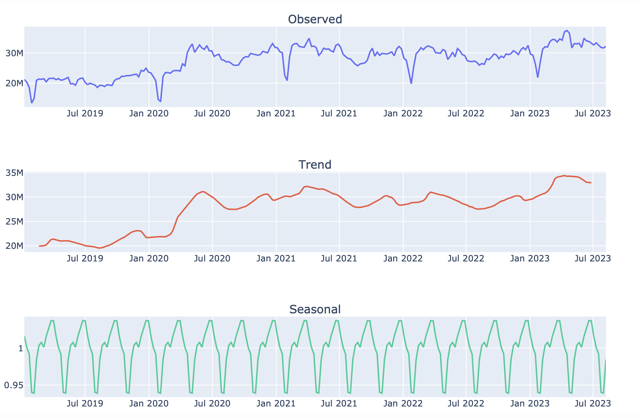
Ensemble Trend and Seasonality Visualized
Seasonal Decomposition – Adobe.com Surface Traffic
¹ Seasonal decomposition plot is a multiplier effect representing quarterly seasonality
² Dataset is fabricated as financial data is confidential to Adobe Finance and Operations

Slide 14
Ensemble Approach Visualized
PY Actual
Monthly Decomp.
Funnel Prior Actual
Actual
Actual
Train
Test
Forecast
Seasonality
calendars aligned by working week of fiscal quarter
PY
Monthly Decomp.
Funnel Prior Forecast.
2-year moving average
Forecast
Regression
Trend

Slide 15
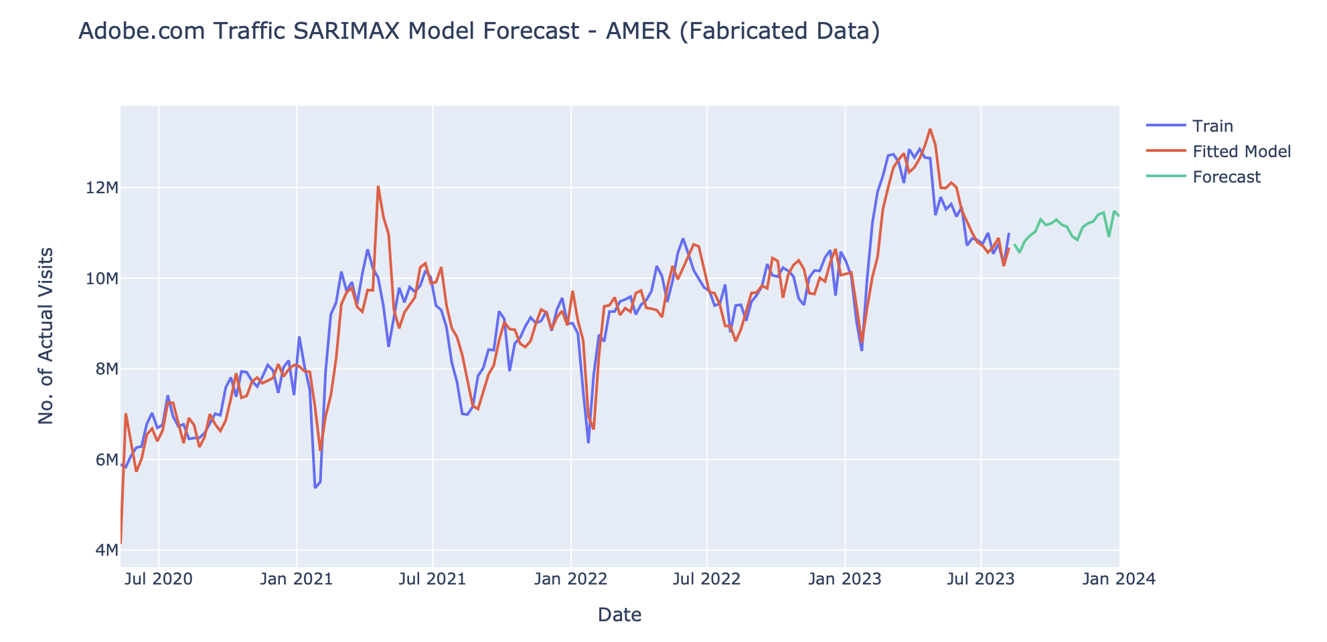
DDOM is Dynamic.
DDOM is written dynamically, meaning it can easily be applied to each granular forecast.
¹ Dataset is fabricated as financial data is confidential to Adobe Finance and Operations

Slide 16
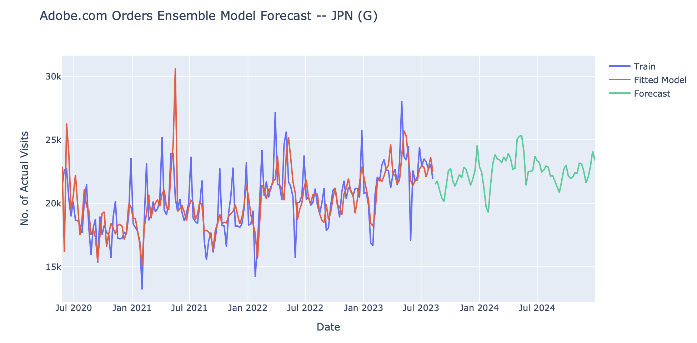
DDOM is Autonomous.
DDOM is also autonomous, meaning forecasts can be run with a single click of a button.
¹ Dataset is fabricated as financial data is confidential to Adobe Finance and Operations

Slide 17
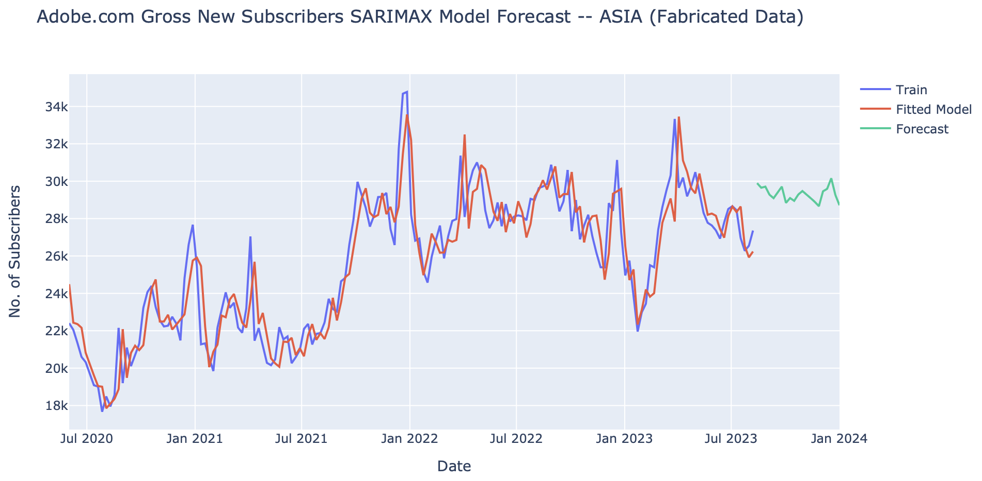
DDOM is Optimized.
Lastly, DDOM forecasts are optimized, meaning each granular forecast is uniquely fine-tuned and adjusted to produce the most accurate results.
¹ Dataset is fabricated as financial data is confidential to Adobe Finance and Operations

Slide 18
DDOM Results and Performance

Slide 19
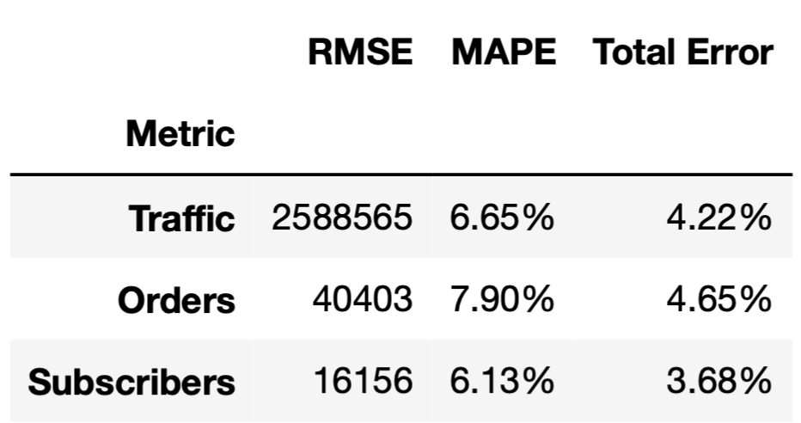
Validation Metrics Explained
Three methods are used to assess model performance:
RMSE
Forecast Accuracy (MAPE)
Guidance Accuracy (Total Error)
RMSE
Root Mean Squared Error
Measures how close predictions are to actuals on average (in units).
Forecast Accuracy (MAPE)
Measures the forecast’s absolute accuracy in relative percentages.
Average percent error between predictions and actuals.
Guidance Accuracy (Total Error)
Measures the forecast’s net accuracy in relative percentages.
Useful criteria for analyzing aggregate model forecasts.

Slide 20
Model Selection & Comparison
Ensemble has shown generally the best performance among various models and reduced variance.
Metric | Model | RMSE | MAPE | Total Error
Surface Traffic | SARIMAX | 2,588,565 | 6.65% | 4.22%
 | FB Prophet | 1,616,788 | 3.83% | 4.86%
Simple OLS | Ensemble | 1,986,678 | 4.95% | 3.20%
Checkout Traffic | SARIMAX | 170,347 | 5.02% | 0.27%
 | FB Prophet | 227,163 | 6.65% | 1.70%
 | Ensemble | 166,602 | 5.01% | 2.47%
Orders | SARIMAX | 32,231 | 5.31% | 0.51%
 | FB Prophet | 37,564 | 7.34% | 0.84%
 | Ensemble | 32,067 | 5.75% | 2.13%
Subscribers | SARIMAX | 16,156 | 6.13% | 3.68%
 | FB Prophet | 10,526 | 3.39% | 3.96%
 | Ensemble | 12,406 | 4.37% | 2.49%

Slide 21
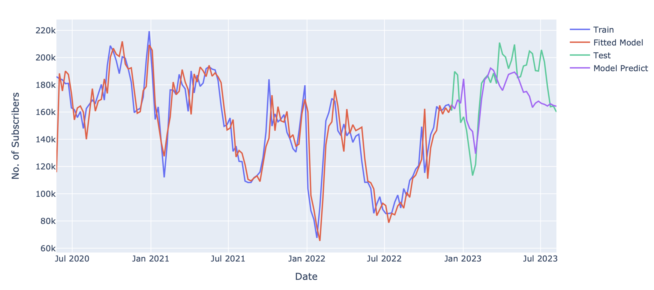
Model Validation Visualized
¹ Dataset is fabricated as financial data is confidential to Adobe Finance and Operations

Slide 22
Model Out-of-Sample Forecast Results
Since starting model development, we’ve had 7 weeks to compare our model’s forecast to actuals.
Surface Traffic
1.46% Total Error
Checkout Traffic
8.87% Total Error
Orders
2.76% Total Error
Subscribers
0.93% Total Error

Slide 23
DDOM Demo
Click for DDOM

Slide 24
DDOM’s Impact & Adobe Values

Slide 25

DDOM embraces Adobe’s core values.
Raise the bar.
Pioneering Tech Stack in FinOps
Databricks & Github
Create the future.
Transformation across FP&A
Automated System with AI
Leveraging AI
Machine Learning Approach
Scalable, Robust, Accurate
Impact: Estimated to save roughly 500 hours per year in FP&A processes.

Slide 26
Caveats and Next Steps

Slide 27




DDOM Caveats
Need more granularity (device & marketing)
Vulnerable to isolated shocks (Firefly)
Technology stack is not entirely seamless

Slide 28
DDOM Next Steps
Explore forecasting at the device type & marketing channel level
Add holidays and isolated shocks to list of regression exogeneous variables
Improve connection and import/export between TM1 and Databricks

Slide 29
Q&A

